Slide 1
Network Flow Visualization
Paul Krystosek, PhD
CERT Network Situational Awareness Group March 2014

Slide 2
© 2011 Carnegie Mellon University
NO WARRANTY
THIS MATERIAL OF CARNEGIE MELLON UNIVERSITY AND ITS SOFTWARE ENGINEERING INSTITUTE IS FURNISHED ON AN “AS-IS" BASIS. CARNEGIE MELLON UNIVERSITY MAKES NO WARRANTIES OF ANY KIND, EITHER EXPRESSED OR IMPLIED, AS TO ANY MATTER INCLUDING, BUT NOT LIMITED TO, WARRANTY OF FITNESS FOR PURPOSE OR MERCHANTABILITY, EXCLUSIVITY, OR RESULTS OBTAINED FROM USE OF THE MATERIAL. CARNEGIE MELLON UNIVERSITY DOES NOT MAKE ANY WARRANTY OF ANY KIND WITH RESPECT TO FREEDOM FROM PATENT, TRADEMARK, OR COPYRIGHT INFRINGEMENT.
Use of any trademarks in this presentation is not intended in any way to infringe on the rights of the trademark holder.
This Presentation may be reproduced in its entirety, without modification, and freely distributed in written or electronic form without requesting formal permission. Permission is required for any other use. Requests for permission should be directed to the Software Engineering Institute at permission@sei.cmu.edu.
This work was created in the performance of Federal Government Contract Number FA8721-05-C-0003 with Carnegie Mellon University for the operation of the Software Engineering Institute, a federally funded research and development center. The Government of the United States has a royalty-free government-purpose license to use, duplicate, or disclose the work, in whole or in part and in any manner, and to have or permit others to do so, for government purposes pursuant to the copyright license under the clause at 252.227-7013.

Slide 3
Learning Objectives
Purposes of visualization
Types of visualization
Preparing data for visualization
Rendering the data into an image file

Slide 4
Overview
Introduction
Data Preparation
Visualization
Guidelines for useful visualization
Resources for further study

Slide 5
Schedule 3/17/2014
Time | Topic
1600 | Introduction
1630 | Bar charts
1700 | Hands on
1730 | Scatterplots
1800 | Hands on
1830 | Time Series
1900 | Hands on
1930 | More Time Series, summary and conclusions
2000 | Adjourn

Slide 6
Schedule 3/18/2014
Time | Topic
0900 | Introduction
0930 | Bar charts
1000 | Hands on
1030 | Scatterplots
1100 | Hands on
1130 | Time Series
1200 | Hands on
1230 | More Time Series, summary and conclusions
1300 | Adjourn

Slide 7
History
Not many areas of endeavor can trace their origin to a specific time or event
When did data visualization start?
London, 1854
A cholera epidemic is rampant in part of the city
Everyone has a theory or superstition of cause, most have to do with “bad air” (the London sewer system wasn’t even proposed until 1856)
Dr. John Snow annotates a London map with the location of deaths from cholera
The results point to a cause, which few believe

Slide 8
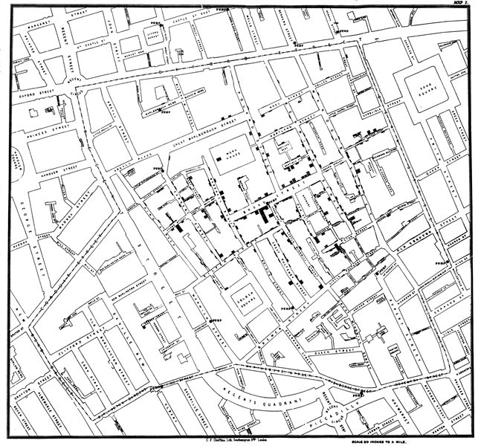

Slide 9
Terminology 1
Visualization: | The visual representation of data
Analytic (as a noun): | An operation done at scale automatically when inspecting data
Visual Analytics: | An outgrowth of the fields of information visualization and scientific visualization that focuses on analytical reasoning facilitated by interactive visual interfaces.

Slide 10
Network Flow Analysis
Descriptive
What’s happening? What’s typical
Big picture
Retrospective
Something happened – Describe it:
who what where when and most importantly Where Else
Network profile, Host activity profile
Exploratory
Can I find…?
How would I find X if I think I know what it looks like?
Look for anomalies

Slide 11
Where Visualization meets Analysis
Descriptive displays of
Flow volume
Connectivity
Retrospective
Show details of an event visually to provide more information than flow records and numbers
Who did what, when and to whom
Exploratory
Look at the data grpahically in a way that lets your visual system work its magic

Slide 12
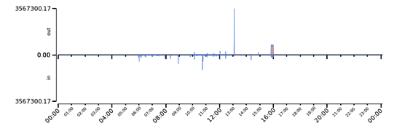
What is Visualization?
2009/04/21T05:08:00| 12.30| 8161.04| 59.56|
2009/04/21T05:08:30| 8.26| 8166.79| 56.22|
2009/04/21T05:09:00| 8.87| 11215.58| 70.47|
2009/04/21T05:09:30| 13.45| 16130.48| 95.13|
2009/04/21T05:10:00| 16.67| 19832.34| 100.31|
2009/04/21T05:10:30| 44.08| 66908.36| 313.00|
2009/04/21T05:11:00| 20.50| 28254.99| 173.58|
2009/04/21T05:11:30| 18.51| 25062.87| 145.51|
2009/04/21T05:12:00| 17.51| 131405.17| 214.23|
2009/04/21T05:12:30| 9.84| 216071.23| 237.08|
2009/04/21T05:13:00| 17.92| 318430.82| 341.70|
2009/04/21T05:13:30| 11.77| 16201.26| 69.02|
2009/04/21T05:14:00| 10.56| 6976.32| 62.86|
2009/04/21T05:14:30| 12.43| 13986.72| 110.52|
2009/04/21T05:15:00| 12.88| 9812.91| 67.21|
2009/04/21T05:15:30| 6.90| 21058.38| 60.80|
2009/04/21T05:16:00| 8.25| 27902.46| 72.16|
2009/04/21T05:16:30| 9.24| 29105.09| 76.92|
2009/04/21T05:17:00| 13.42| 25206.42| 78.32|
2009/04/21T05:17:30| 15.12| 46165.45| 133.83|
2009/04/21T05:18:00| 34.26| 10630.63| 84.47|
2009/04/21T05:18:30| 7.58| 12376.57| 63.49|
2009/04/21T05:19:00| 11.95| 16135.02| 77.89|
2009/04/21T05:19:30| 9.22| 18054.08| 66.06|
2009/04/21T05:20:00| 11.26| 7648.36| 58.91|

Slide 13
Where it is useful
For use by an analyst
Initial exploration of unknown flow data
Finding specific patterns
Look for trends
See what doesn’t look right
For explaining stuff to others
Some people are visual learners
Including graphs or diagrams helps get your point across

Slide 14
Where it isn’t that useful
Every type of display seems to have a useful data volume range
Not enough data and it doesn’t say much
Too much data and it is unreadable
If it is not labeled properly, it is neither understandable or useful
Be careful of multiple interpretations
Be careful of implying cause and effect

Slide 15
Visualization, or visualization related packages
Dedicated visualization
Rayon
Gnuplot
GraphViz
Stuff that also does viz
Excel, Centrifuge, Tableau
R (more correctly The R Statistical Package)
Analyst’s Notebook
Everest
21CT Lynxeon
Palantir

Slide 16
Popular types of visualization:
Bar Chart
Time Series
Scatter Plot
Histogram
Link diagram (directed graph)
Heat Map
Other
Geograpic maps
Pie charts

Slide 17
Software to do visualization: Rayon
There other visualization software packages
Rayon was written to work and play well with SiLK and Python
It fits in with the Unix pipe mode of scripting
It doesn’t (yet?) handle everything we want to do
Viz Type | Application
Bar Chart | rycategories
Time Series | rytimeseries
Scatter Plot | ryscatterplot
Histogram | rycategories
Link diagram | GraphViz
Heat Map | ryhilbert

Slide 18
How to prepare Viz
Get raw data
Raw data
Process into what we want
Data we want
Prepare proper format
Data in format
Render into viz
Viz

Slide 19
Bar Charts

Slide 20
Terminology 2
Continuous | Each continuous function from the real line to the rationals is constant, since the rationals are totally disconnected. Ummm, why don’t we just say that continuous is the opposite of discrete Example: Temperature
Discrete | The opposite of continuous… oh sorry That which can be perceived individually and not as connected to, or part of something else. Example: Number of words in a sentence. Not to be confused with discreet.
Distribution | The frequency of occurrence or extent of existence. The number of words in each sentence of a book.

Slide 21
Bar Chart
Counts of discrete (rather than continuous) items or activities. Used for:
Counts of activities of interest
Example:
Counts of flows by protocol
Distribution of port or usage
Distribution of addresses or ports scanned

Slide 22
How to prepare Viz
Get raw data
Raw data
Process into what we want
Data we want
Prepare proper format
Data in format
Render into viz
Viz

Slide 23
Bar Chart, simplified
Start with a text file of the data to be graphed
Run it through rycategories
View it with appropriate viewer
Paint
Office picture manager
Browser

Slide 24
Bar Chart Example
Example bar chart: population of continents
Create input text file
North America
Population 528,720,588
Area: 24709000 Sq km
Countries: 23

Slide 25
Statistics for the seven continents
Continent | Population | Area (km²) | Number of Countries
North America | 528,720,588 | 24,709,000 | 23
South America | 387,489,196 | 17,840,000 | 12
Europe | 739,165,030 | 10,180,000 | 50
Asia | 4,164,252,000 | 44,579,000 | 49
Africa | 1,032,532,974 | 30,221,532 | 54
Australia | 36,000,000 | 8,600,000 | 3
Antarctica | 0 | 14,000,000 | 0

Slide 26
Input file needs to look like this
manton $ cat barchart-cont.txt
North America|528720588|24709000|23
South America|387489196|17840000|12
Europe|739165030|10180000|50
Asia|4164252000|44579000|49
Africa|1032532974|30221532|54
Australia|36000000|8600000|3
Antarctica|0|14000000|0
manton $

Slide 27
Script to produce bar chart
# Bar chart of continent populations
rycategories \
--input-path barchart-cont.txt \
--output-path barchart-cont.png

Slide 28
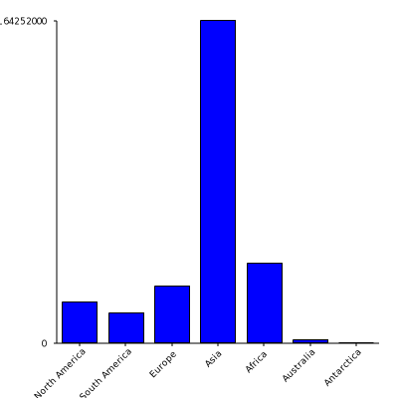
Bar Chart Ex 1: Continent Population

Slide 29
Things to note
X axis has category names from the data file
Y axis scale notation has min and max values but nothing in between
Categories are in the order they appear in input file
No title
No X or Y axis annotation
We didn’t tell it what data to use, so, what did it do?

Slide 30
rycategories
Common options
--input-path=<file>
--output-path=<image file>
jpg, png, svg
--title, --caption, --left-label, --bottom-label, --caption
--cat-input <colspec>
--val-input <colspec>
--bar-width <num>
--bar-fill-color <color>
--val-scale <scale>
--val-scale-min <num>

Slide 31
Add annotation (same data more readable)
# Bar chart of continent populations with annotation
rycategories \
--input-path=barchart-cont.txt \
--title="Populations of the seven continents" \
--caption="Continents" \
--left-label="Population count" \
--output-path bar-cont-pop-annot.png

Slide 32
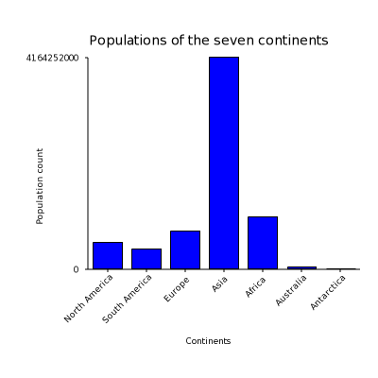
Bar Chart Example Output 2

Slide 33
How to prepare Viz
Get raw data
Raw data
Process into what we want
Data we want
Prepare proper format
Data in format
Render into viz
Viz

Slide 34
How to use Rayon to prepare viz
rwfilter
File.rw
Rwcount, rwuniq, rwstats…
File.txt
sort
File2.txt
Ry<whatever>
Viz.png

Slide 35
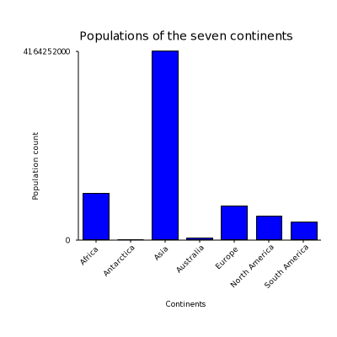
Sort the output as you want it: alpha
# Bar chart of continent populations
sort barchart-cont.txt | \
rycategories \
--title="Populations of the seven continents" \
--caption="Continents" \
--left-label="Population count" \
--bottom-label=" " \
--output-path bar-cont-annot-sortalpha.png

Slide 36
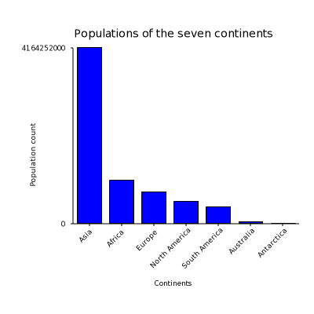
Sort the output as you want it:numeric
# Bar chart of continent populations
sort --numeric-sort \
--key=2 \
--field-separator="|" \
--reverse \
barchart-cont.txt | \
rycategories \
--title="Populations of the seven continents" \
--caption="Continents" \
--left-label="Population count" \
--bottom-label=" " \
--output-path bar-cont-pop-annot-sortnum.png

Slide 37
Remember the multi-column input file
$ cat barchart-cont.txt
North America|528720588|24709000|23
South America|387489196|17840000|12
Europe|739165030|10180000|50
Asia|4164252000|44579000|49
Africa|1032532974|30221532|54
Australia|36000000|8600000|3
Antarctica|0|14000000|0
$

Slide 38
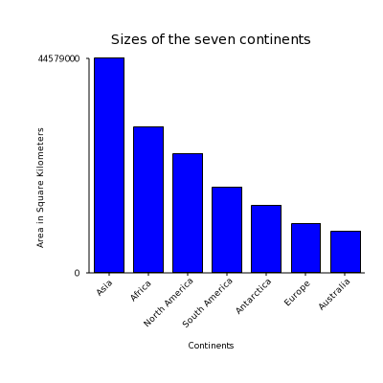
Selecting from different input columns
# Bar chart of continent sizes
sort --numeric-sort \
--key=3 \
--field-separator="|" \
--reverse \
barchart-cont.txt | \
rycategories \
--cat-input=0 \
--val-input=2 \
--title="Sizes of the seven continents" \
--caption="Continents" \
--left-label="Area in Square Kilometers" \
--bottom-label=" " \
--output-path barchart-cont-annot-sortsize.png

Slide 39
How to prepare Viz
Get raw data
Raw data
Process into what we want
Data we want
Prepare proper format
Data in format
Render into viz
Viz

Slide 40
How to use SiLK & Rayon to prepare viz
rwfilter
File.rw
Rwcount, rwuniq, rwstats…
File.txt
sort
File2.txt
Ry<whatever>
Viz.png

Slide 41
Bar Chart starting with SiLK
Let’s try a simple look at network data
What SiLK types are in the flow
Types: in, inweb, out, outweb…
And how many of each
Get data with rwfilter
Determine flows per type with rwuniq
Produce graph with rycategories

Slide 42
Get and process flow type
#echo Bar chart of flow types
rwfilter --start-date=2009/04/21 \
--pass=stdout \
--type=all \
--proto=0- | \
rwuniq --fields=type \
--no-titles

Slide 43
Output from get and prep script
[pkrystos@yuma 09]$ ./barchart-get-proc.sh
outweb| 3594142|
ipv6out| 80|
ipv6int2int| 62|
int2int| 30381|
in| 1960591|
ipv6in| 139|
out| 1283296|
inweb| 4005213|
ext2ext| 8|
[pkrystos@yuma 09]$

Slide 44
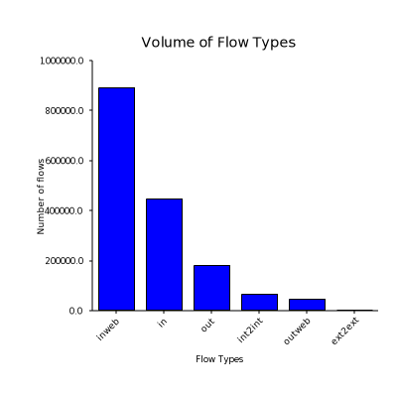
Get, process, prepare and viz
# Bar chart of Flow Types
rwfilter --start-date=2013/06/28:15 \
--sensor=S1 \
--pass=stdout \
--type=all \
--proto=0- | \
rwuniq --fields=type \
--no-titles | \
sort --numeric \
--reverse \
--key=2 \
--field-separator="|" | \
rycategories --input-path - \
--val-ticks="n(5)" \
--title="Volume of Flow Types" \
--caption="Flow Types" \
--left-label="Number of flows" \
--output-path=barchart-flowtype.png

Slide 45
Question on prep for graph
We use SiLK commands here… so
Why was sort used instead of rwsort?

Slide 46
Exercises
Produce a bar chart of counts of countries by continent
For the following, use an hour’s worth of data from one sensor
Produce a bar chart of counts of flows by protocol
Produce a bar chart of counts of bytes by protocol

Slide 47
Scatter Plots

Slide 48
Scatter Plot Basics
What is it?
Two dimensional representation of the relationship between two sets of values
Where are they used?
Looking for (visual) relationship (perhaps correlation) between two values
Clustering

Slide 49
Terminology 3
Scatterplot | A scatter plot, scatterplot, or scattergraph is a type of mathematical diagram using Cartesian coordinates to display values for two variables for a set of data.
Cluster Clustering Cluster Analysis | The task of grouping a set of objects in such a way that objects in the same group (called a cluster) are more similar (in some sense or another) to each other than to those in other groups (clusters). It is a main task of exploratory data mining, and a common technique for statistical data analysis, used in many fields, including machine learning, pattern recognition, image analysis, information retrieval, and bioinformatics.
Correlation | Correlation is a measure of relationship between two mathematical variables or measured data values, which includes the Pearson correlation coefficient as a special case.

Slide 50
ryscatterplot
Common options
--input-path=<file>
--output-path=<image file>
jpg, png, svg
--x-input=<value>
--y-input=<value>
--marker-size=<int>
--title, --caption, --left-label, --bottom-label, --caption

Slide 51
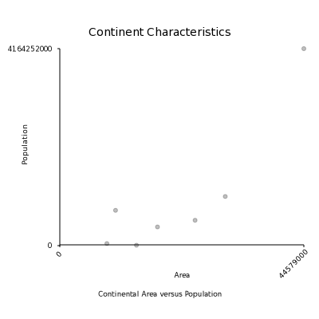
Scatterplot of Area vs Population
rm -f area-pop.png
ryscatterplot --input-path=continents.txt \
--x-input=2 \
--y-input=1 \
--marker-size=5 \
--title="Continent Characteristics" \
--caption="Continental Area versus Population" \
--left-label="Population" \
--bottom-label="Area" \
--output-path=area-pop.png

Slide 52
Make it easier to read and maintain
NAME=0
POPULATION=1
AREA=2
COUNTRIES=3
FILE=area-pop
rm -f $FILE.png
$BINDIR/ryscatterplot --input-path=continents.txt \
--x-input=$AREA \
--y-input=$POPULATION \
--marker-size=5 \
--title="Continent Characteristics" \
--caption="Continental Area versus Population" \
--left-label="Population" \
--bottom-label="Area" \
--output-path=$FILE.png

Slide 53
ICMP Type and Code data example
# create scatterplot showing icmp type and code usage
START=2014/03/12
rwfilter --start-date=$START \
--type=in \
--proto=1 \
--pass=stdout \
| rwcut --fields=icmptypecode --no-titles \
| sort \
| uniq
0| 0|
0| 80|
11| 0|
11| 1|
12| 0|
121|229|
12| 71|
13| 0|
13| 61|
224| 1|
224| 2|
224| 7|
228|136|
228|207|
3| 0|
3| 1|
3| 10|
3| 13|
3| 2|
3| 3|
3| 4|
3| 9|
4| 0|
5| 1|
8| 0|

Slide 54
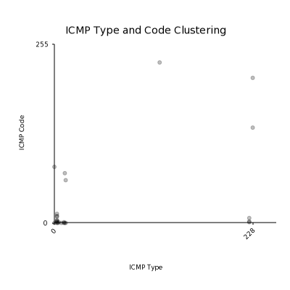
ICMP Cluster script and scatterplot
FILE=type-code
rm -f $FILE.png
ryscatterplot --input-path=$FILE.txt \
--marker-size=5 \
--x-scale-min=0 \
--y-scale-min=0 \
--x-scale-max=255 \
--y-scale-max=255 \
--title="ICMP Type and Code Clustering" \
--caption="ICMP Type" \
--left-label="ICMP Code" \
--output-path=$FILE-scaled.png

Slide 55
Exercises
Find a time and sensor that has ICMP Type and Code anomalies and scatter plot it.
Other things to plot:
Source vs Destination ports
Duration vs packets or bytes
Bytes vs packets

Slide 56
Exercises, continued
Second order analysis to plot:
Distribution of number of ports scanned
Distribution of number of addresses scanned

Slide 57
Time Series

Slide 58
Time Series
An indication of activity over time. Good for spotting:
- General indication of activity
- When something starts, ends or transitions
- Trends and patterns of activity
- Temporal relationships
Beacons
Something sent and a reply received
Example:
- Bytes, packets or flows over time

Slide 59
Terminology 4
Time series | A time series is a sequence of data points, measured typically at successive points in time spaced at uniform time intervals. Examples of time series are the daily closing value of the Dow Jones Industrial Average and the annual flow volume of the Nile River at Aswan.

Slide 60
rytimeseries
Common Options
--style (dots, lines, filled_lines, bars)
--time-column <colname>
--top-column <colname>
--top-filter <filter-expr>
--top-label <string>
--annotate-max

Slide 61
How to prepare Viz
Get raw data
Raw data
Process into what we want
Data we want
Prepare proper format
Data in format
Render into viz
Viz

Slide 62
Get and prep data for Timeseries
rwfilter --start-date=2009/4/22 \
--end-date=2009/4/22 \
--type=in,inweb \
--proto=0- \
--pass=stdout \
| rwcount --bin-size=3600

Slide 63
Get and prep data for timeseries
Date| Records| Bytes| Packets|
2009/04/22T00:00:00| 424.03| 338617.32| 2509.37|
2009/04/22T01:00:00| 407.61| 347845.16| 2675.30|
2009/04/22T02:00:00| 391.44| 341821.49| 2596.63|
2009/04/22T03:00:00| 592.03| 3705105.79| 6635.34|
2009/04/22T04:00:00| 21720.85| 10500442.09| 44777.52|
2009/04/22T05:00:00| 37026.93| 32130070.03| 133722.00|
2009/04/22T06:00:00| 91899.33| 3575289457.77| 2598329.24|
2009/04/22T07:00:00| 25307.84| 61928357.41| 175475.69|
2009/04/22T08:00:00| 9126.01| 30744342.15| 70457.06|
2009/04/22T09:00:00| 241700.50| 37376819.65| 320659.44|
2009/04/22T10:00:00| 109619.43| 152503180.64| 320986.96|
2009/04/22T11:00:00| 10334.77| 66543766.83| 122384.87|
2009/04/22T12:00:00| 1604.11| 3734083.52| 14790.25|
2009/04/22T13:00:00| 137136.46| 9805925.01| 163959.81|
2009/04/22T14:00:00| 194334.45| 15460927.51| 225197.13|
2009/04/22T15:00:00| 1485.96| 4482245.06| 12750.17|
2009/04/22T16:00:00| 434.57| 562711.85| 6037.00|
2009/04/22T17:00:00| 687.22| 683884.32| 6956.07|
2009/04/22T18:00:00| 1091.52| 641085.43| 7328.72|
2009/04/22T19:00:00| 799.95| 592542.53| 6523.54|
2009/04/22T20:00:00| 753.96| 584149.07| 6473.24|
2009/04/22T21:00:00| 741.95| 578009.41| 6395.25|
2009/04/22T22:00:00| 707.80| 578178.62| 6385.92|
2009/04/22T23:00:00| 708.10| 574992.24| 6348.32|
2009/04/23T00:00:00| 5.21| 121415.09| 1195.16|

Slide 64
Simple Timeseries
FILE=in-inweb
rm -f $FILE.png
./traffic-in-inweb.sh | \
$BINDIR/rytimeseries --input-path - \
--title="CDX 2009 in, inweb traffic" \
--output-path $FILE.png \
--time-column 0 \
--top-column 2 \
--top-label=out \
--style=filled_lines

Slide 65
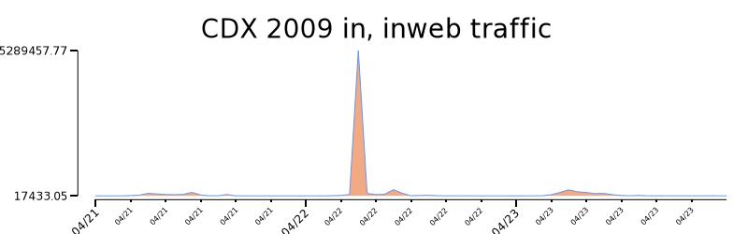
Simple uni-directional traffic plot

Slide 66
Plot flow directions separately
RWFILTER_ARGS="--start-date=2009/04/21 --pass=stdout"
#echo In Web traffic
# In Web traffic
rwfilter $RWFILTER_ARGS --type=inweb --proto=6 | \
rwcount --no-titles | sed "s/^/Web\|In|/"
#echo Out Web traffic
# Out Web traffic
rwfilter $RWFILTER_ARGS --type=outweb --proto=6 | \
rwcount --no-titles | sed "s/^/Web\|Out|/"
Web|In|2009/04/21T00:05:00| 2.09| 2530.96| 13.35|
Web|In|2009/04/21T00:05:30| 1.33| 700.72| 5.33|
Web|In|2009/04/21T00:06:00| 0.33| 532.72| 1.33|
Web|In|2009/04/21T00:06:30| 0.25| 395.61| 0.99|
Web|In|2009/04/21T00:07:00| 0.00| 0.00| 0.00|
Web|In|2009/04/21T00:07:30| 0.00| 0.00| 0.00|
Web|In|2009/04/21T00:08:00| 0.00| 0.00| 0.00|
Web|In|2009/04/21T00:08:30| 0.00| 0.00| 0.00|
Web|In|2009/04/21T00:09:00| 0.00| 0.00| 0.00|
Web|In|2009/04/21T00:09:30| 0.00| 0.00| 0.00|
Web|Out|2009/04/21T23:49:00| 2.00| 319.00| 7.00|
Web|Out|2009/04/21T23:49:30| 0.00| 0.00| 0.00|
Web|Out|2009/04/21T23:50:00| 1.00| 400.00| 6.00|
Web|Out|2009/04/21T23:50:30| 3.00| 120.00| 3.00|
Web|Out|2009/04/21T23:51:00| 0.00| 0.00| 0.00|
Web|Out|2009/04/21T23:51:30| 3.00| 120.00| 3.00|
Web|Out|2009/04/21T23:52:00| 0.00| 0.00| 0.00|
Web|Out|2009/04/21T23:52:30| 0.00| 0.00| 0.00|
Web|Out|2009/04/21T23:53:00| 0.00| 0.00|0.00|
Web|Out|2009/04/21T23:53:30| 3.00| 120.00| 3.00|
Web|Out|2009/04/21T23:54:00| 2.00| 319.00| 7.00|

Slide 67

Bi-directional script and plot
./in-out-traffic.sh | \
rytimeseries --input-path - \
--output-path in-out.svg \
--time-column 2 \
--top-column 4 \
--top-filter="[1]==Out" \
--top-label=out \
--bottom-column 4 \
--bottom-filter="[1]==In" \
--bottom-label=in \
--style=filled_lines

Slide 68
One more step, multiple plots
FILE=tcp-udp-timeseries
./tcp-udp-traffic.sh | \
rytimeseries --input-path - \
--output-path $FILE.png \
--group-by 0 \
--time-column 2 \
--top-column 4 \
--top-filter="[1]==Out" \
--top-label=out \
--bottom-column 4 \
--bottom-filter="[1]==In" \
--bottom-label=in \
--style=filled_lines

Slide 69
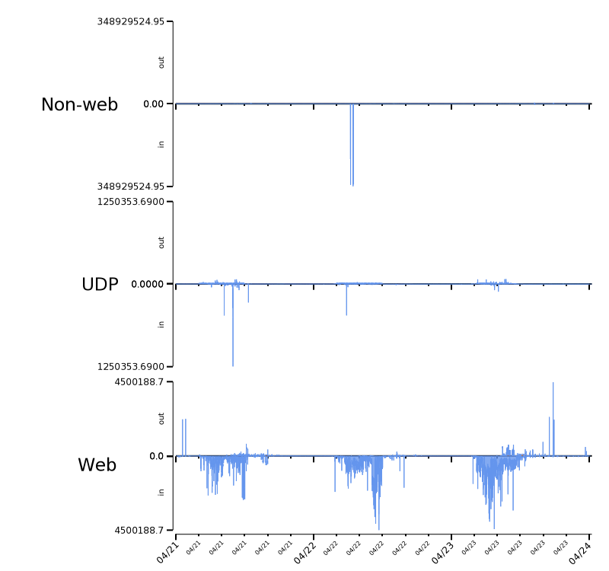
Multiple plot output

Slide 70
Exercises
Plot a sensible amount of data as a time series
Improve on the annotation of my version
Plot all data for multiple sensors as multi plot with each sensor getting its own plot
Try some of the other options

Slide 71
Additional Rayon visualization Modes

Slide 72
Heat Map
A feeble attempt at representing three-dimensional data in a two-dimensional image. Used for:
Showing differences in values that can be plotted on a grid
Example:
Show activity on all ports
Show activity on a network

Slide 73
Hilbert Curve
Similar to a heat map,
A Hilbert curve of IP space shows activity on addresses in a way that relates them in address space
This may be the only instance in recorded history where a serious visualization is inspired by a cartoon

Slide 74
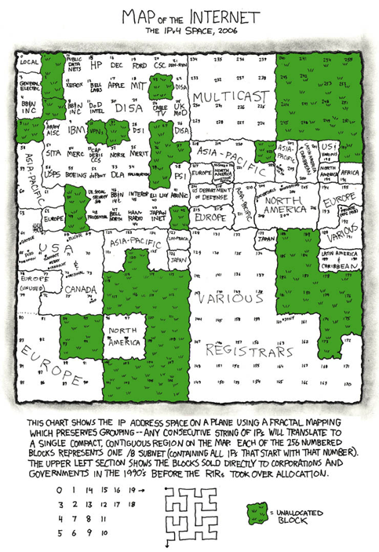

Slide 75
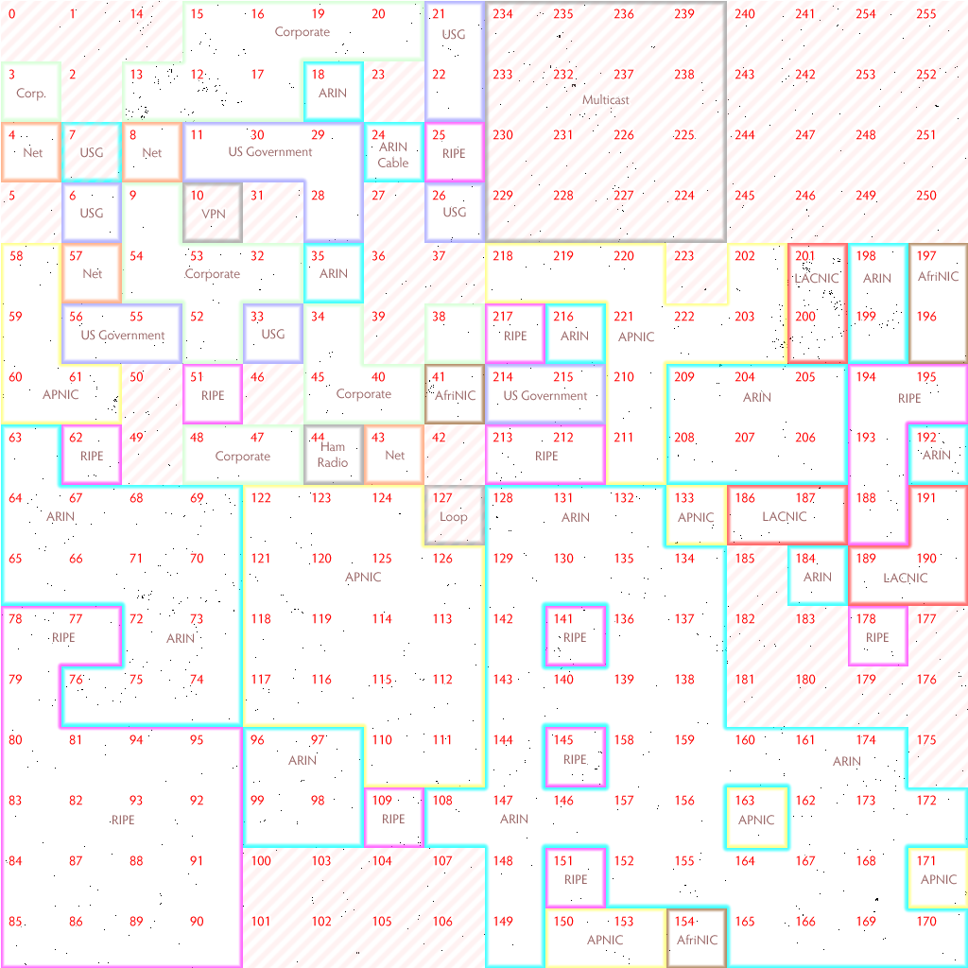
Rayon implementation of Hilbert

Slide 76
Histogram
A representation of tabulated frequencies. Used for:
Showing the distribution of data
Example:
Distribution of
bytes per flow
bytes per packet
Flow duration

Slide 77
Use bar chart to make a histogram
Basic example: Letter Frequency
Select large amount of text
Count number of times each letter is used
Edit as input file
Render with rycategories

Slide 78
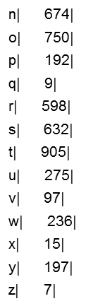
Letter frequency table
a| 816|
b| 149|
c| 278|
d| 425|
e| 1270|
f| 222|
g| 201|
h| 609|
i| 696|
j| 15|
k| 77|
l| 402|
m| 240|

Slide 79
Render script
#echo Bar chart of letter frequency
rycategories --input-path lf.txt \
--title="Letter Frequency Histogram" \
--output-path bar-lf.png

Slide 80
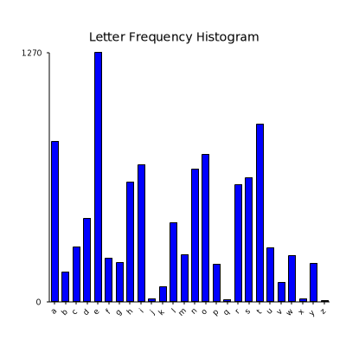

Slide 81
Prepare and render script
#echo Bar chart of letter frequency sorted by frequency
sort --numeric-sort \
--reverse \
--key=2 lf.txt > lf-sorted.txt
rycategories --input-path lf-sorted.txt \
--title=“Letter frequency histogram sorted by frequency” \
--output-path bar-lf-sorted.png

Slide 82
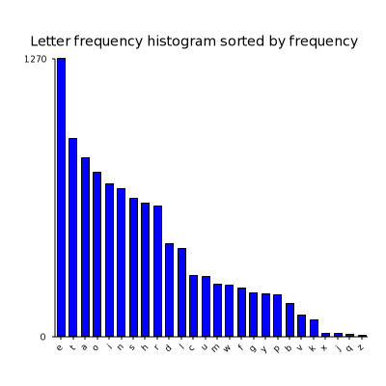

Slide 83
Additional Rayon visualizations
Rayon will make pie charts

Slide 84
Final Thoughts Cool stuff Resources

Slide 85
Link diagram (directed graph)
Called a directed graph by mathematicians and really picky computer scientists. It is used to show the relationship between nodes by linking them with arrows.
Used for:
showing IP Addresses that communicated with one another.
Finding central nodes/hosts
Finding patterns of activity
As the number of nodes and links a link diagram increases
A point is reached where more data makes the graph less usable
The display starts to turn a continuous black because the links and nodes have overlapped significantly

Slide 86
Directed Graphs, a little more explanation
We have four cases
A and B unrelated
A talked to B
B talked to A
A and B conversed
A
B
A
B
A
B
A
B

Slide 87
Graphiz not Rayon
Rayon does not currently support link diagrams
A free package originally developed by AT&T called GraphViz does much of what we want
It consists of the core package and specialized add-ons
See the NetSA ToolTip
Visualizing Associations with Graphviz
https://tools.netsa.cert.org/confluence/display/tt/Visualizing+Associations+with+Graphviz

Slide 88
Example:
Map infrastructure
Show popular web servers
Show which compromised systems communicating with common host

Slide 89
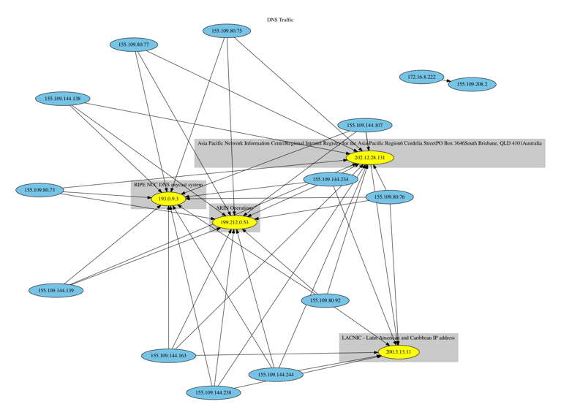
Graphviz Used to Map DNS
Notes:
Graphviz using WhoIs for clustering, used to profile the trusted DNS resolvers for the monitored entity. Showed that no internal machines were making queries outside of the trusted DNS architecture; although one interesting outlier was observed.

Slide 90
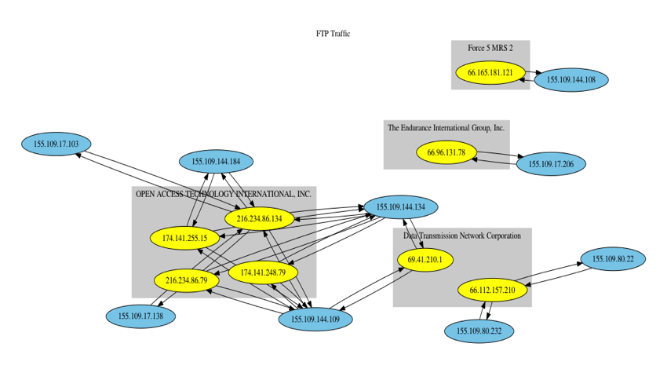
Graphviz Used to Map FTP
Notes:
Graphviz with WhoIs clusters used to map FTP traffic. This was an easy way to look for unauthorized data transfers over a specified time period without manually sorting through raw data.

Slide 91
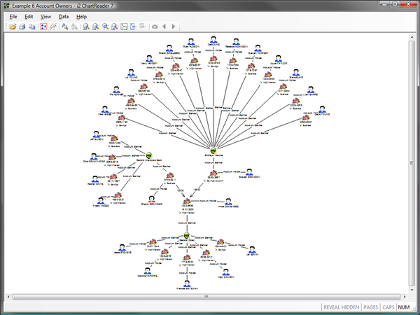
Link diagram from Analyst’s Notebook

Slide 92
Other Visualization techniques
I asked some of the analyst’s to give me their favorite visualization.
Here they are, most of them were done with something other than Rayon.

Slide 93
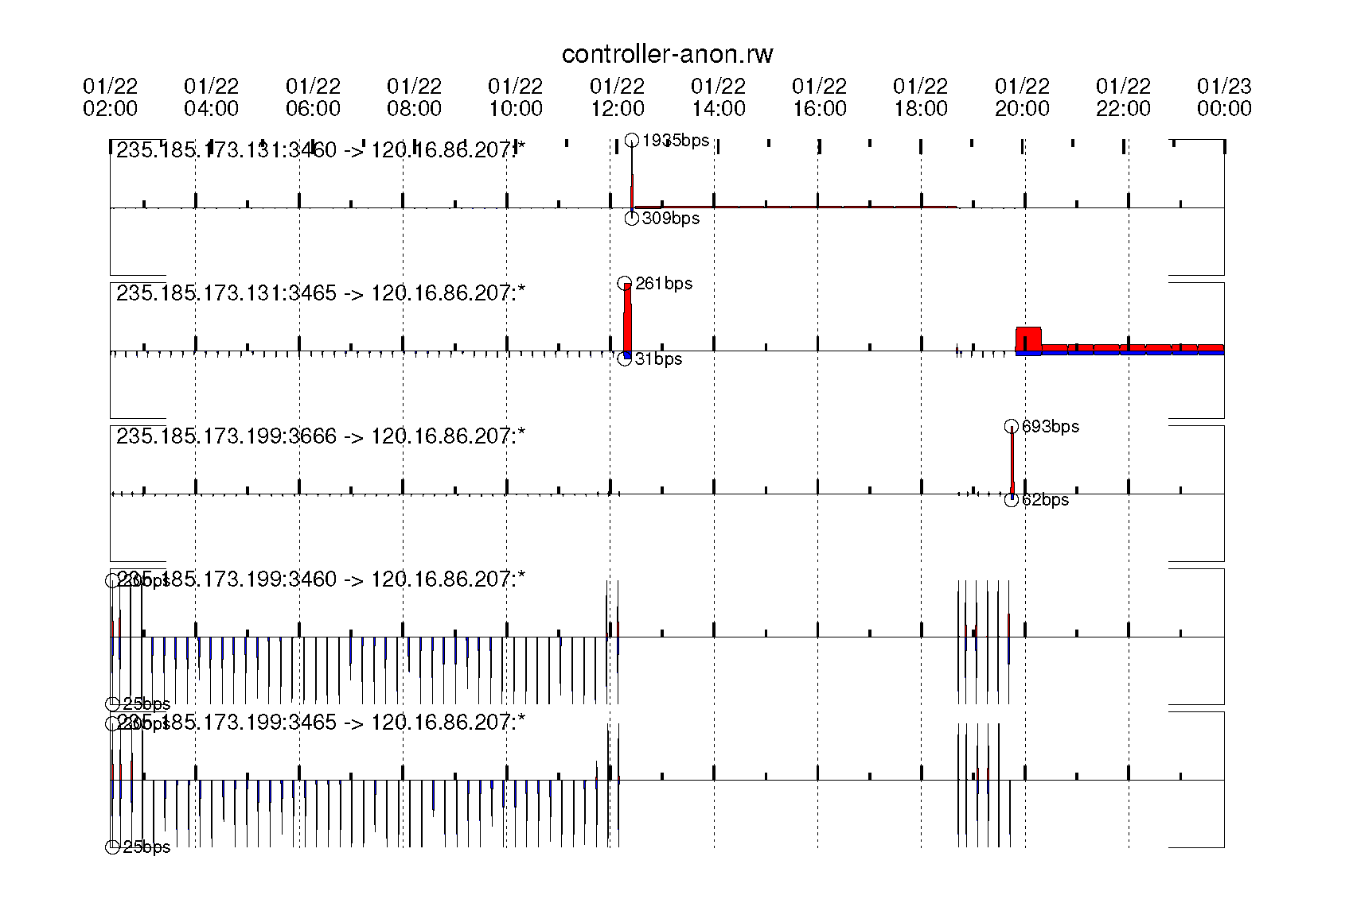
Visualizing Poision Ivy C2 activity

Slide 94
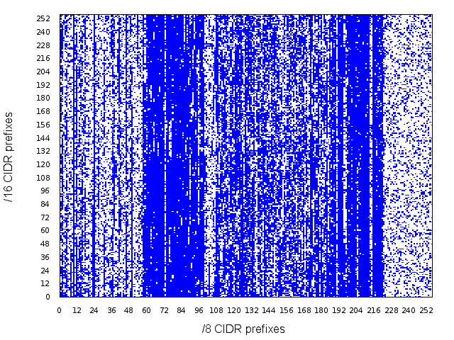
Activity on the Internet

Slide 95
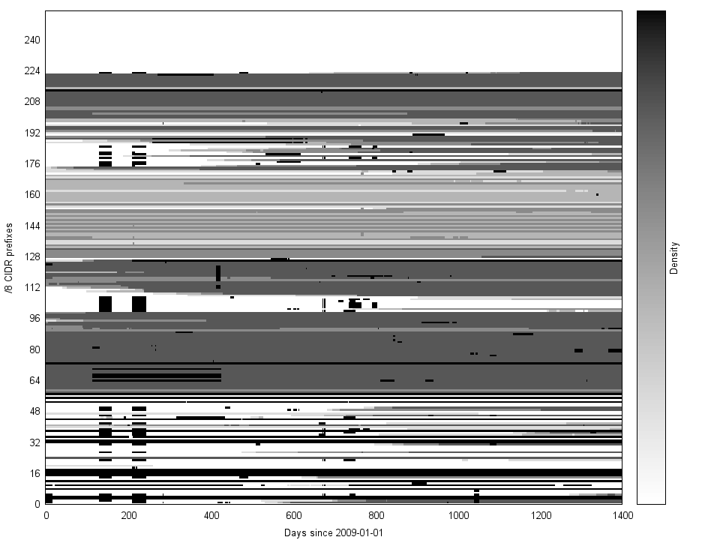
Internet Heat 2009-2013
Routing announcements from 2009 to the beginning of 2013
The darker the color, the more of that /8 was announced

Slide 96
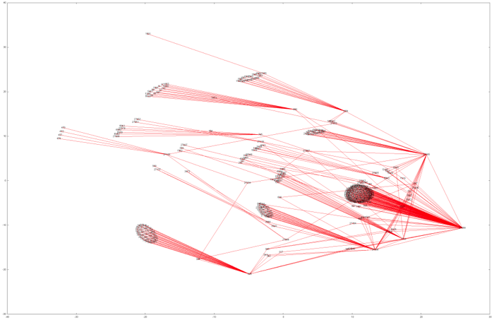
Graph Visualization: DOD Routing Space
Visualizing how DOD routers connect to each other

Slide 97
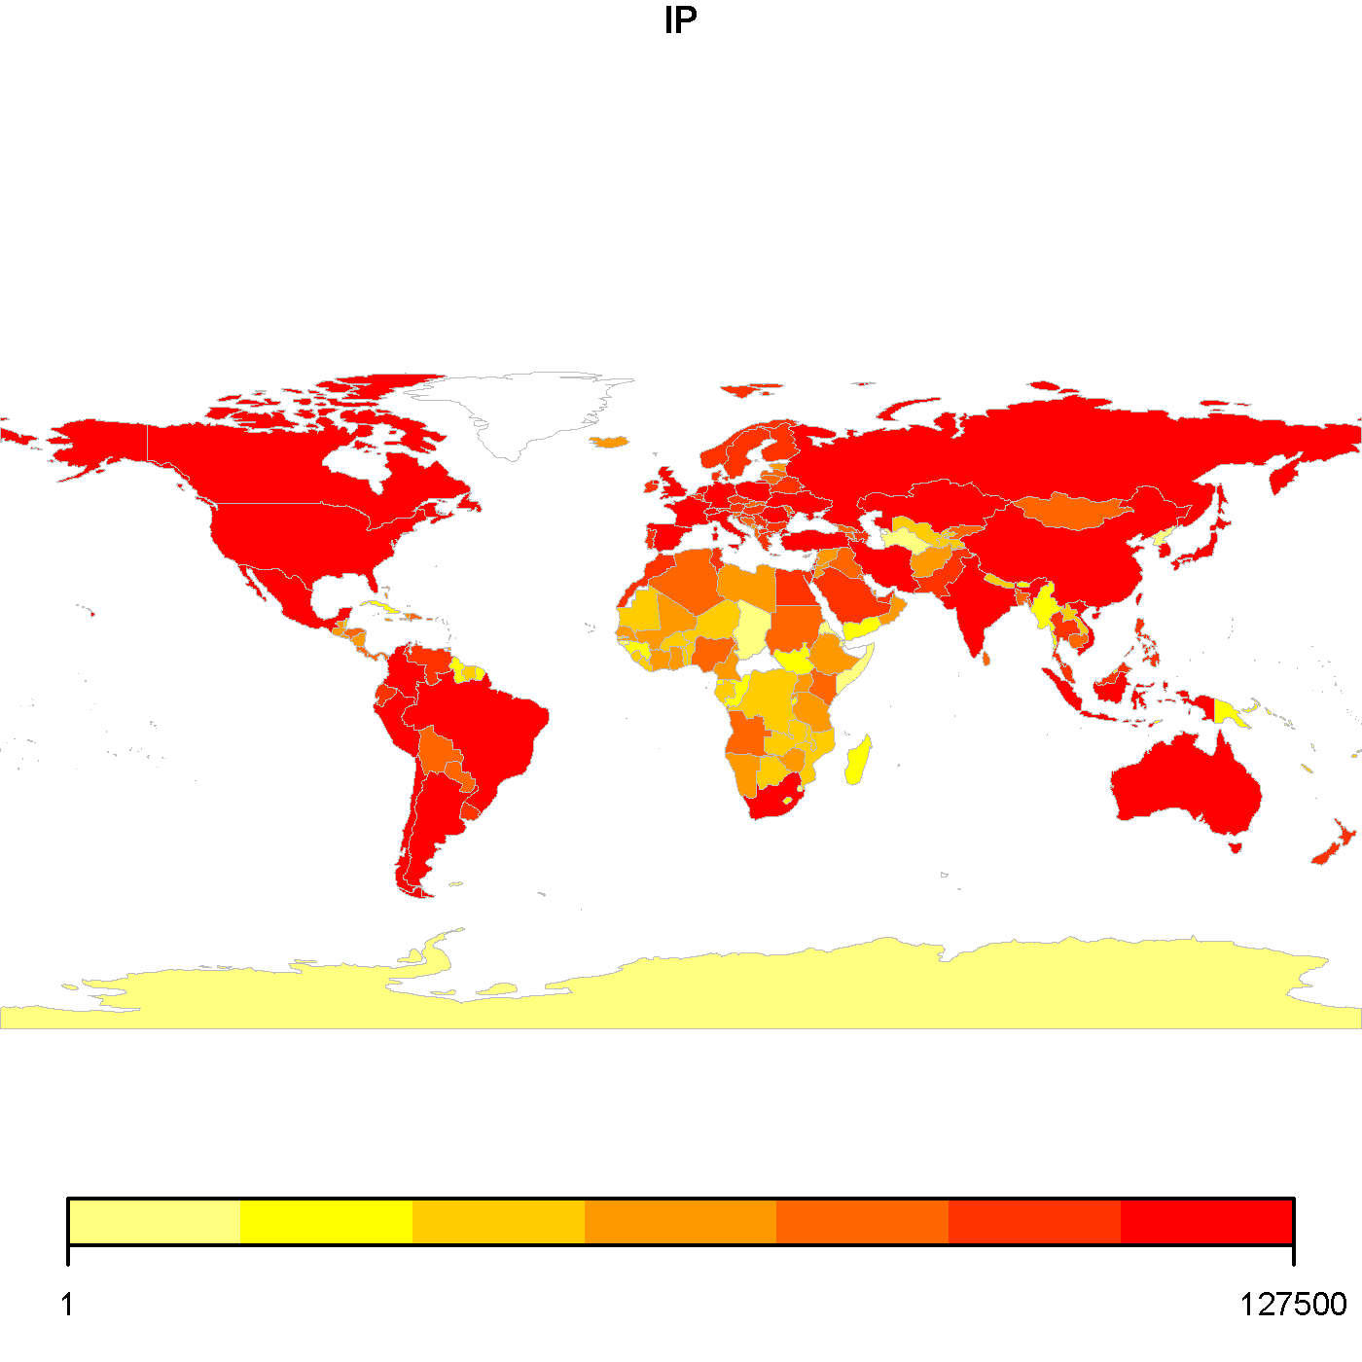
Spam by country

Slide 98
R code to produce “Spam by Country”
require(rworldmap)
library(rworldmap)
data<-read.csv("ipdataset.csv")
sPDF<- joinCountryData2Map(data,joinCode="ISO3",nameJoinColumn="country")
par(mai=c(0,0,0.2,0),xaxs="i",yaxs="i")
mapCountryData( sPDF, nameColumnToPlot="IP")

Slide 99
Data for Spam by Country
1,USA,127451
2,CHN,30573
3,JPN,20777
4,GBR,15192
5,ESP,14433
6,IND,13479
7,DEU,12531
8,KOR,11364
9,FRA,10626
10,ITA,9223
…

Slide 100
32,768 contiguous IP addresses
51-day window
26,830 observed with Variant C
“ballpark” estimate:
147 active in daytime
20 active at night
Notes:
Explain Graph
Each row is aggregation of 256 IP addresses in this network
Brightness represents volume of connections
There are abrupt network IP address allocation changes, occurring twice in the network
But the ballpark estimate stays constant and actually is proportional to the number of IP addresses that were seen in the first month before all of the re-allocating started taking place.
This is a visualization of a /17 network from the Ukraine over 51 days of observation of connection attempts from computers infected with the Conficker-C variant (March 5th through April 24th 2009). The brightness is a measure of the number of connection attempts seen from within the /24 netblock. The rate of connection attempts was based on the software and was stable from machine to machine. But you see here strange changes in the allocation of machines among IP addresses in the Netblock. Starting April 1st all of the high addresses go dark and connections are concentrated behind small numbers of Ip addresses in an almost hourly progression.
This is a story about how we measure size. For if you counted the “size” of the botnet by the number of IP addresses alone, it would appear to grow dramatically on April 1. On the other hand, if you counted by the number of /24s, it would appear to shrink over the same interval. But really, the best indication we have of the population of infected computers behind this network is the connection attempts. Those stay stable.
Why do I like this visualization?
There is nothing particularly flashy about it. It is an image plot and some time series lines. But the devil is in the details. Notice the spacing of the y-axis labels, the choice of heatmap colors (and I had to specifically choose to label 0 counts with black in the image plot code), how the axes are all labeled for information. How the x axes for all 4 images line up exactly, where the dates are labeled and where not, though the tickmarks extend down through the line images for reference. All of these were conscious decisions on my part to build up an integrated view of 4 different plots to tell the very specific story that I want to tell.

Slide 101
Analyst’s explanation
Explain Graph
Each row is aggregation of 256 IP addresses in this network
Brightness represents volume of connections
There are abrupt network IP address allocation changes, occurring twice in the network
But the ballpark estimate stays constant and actually is proportional to the number of IP addresses that were seen in the first month before all of the re-allocating started taking place.
This is a visualization of a /17 network from the Ukraine over 51 days of observation of connection attempts from computers infected with the Conficker-C variant (March 5th through April 24th 2009). The brightness is a measure of the number of connection attempts seen from within the /24 netblock. The rate of connection attempts was based on the software and was stable from machine to machine. But you see here strange changes in the allocation of machines among IP addresses in the Netblock. Starting April 1st all of the high addresses go dark and connections are concentrated behind small numbers of Ip addresses in an almost hourly progression.
This is a story about how we measure size. For if you counted the “size” of the botnet by the number of IP addresses alone, it would appear to grow dramatically on April 1. On the other hand, if you counted by the number of /24s, it would appear to shrink over the same interval. But really, the best indication we have of the population of infected computers behind this network is the connection attempts. Those stay stable.
Why do I like this visualization?
There is nothing particularly flashy about it. It is an image plot and some time series lines. But the devil is in the details. Notice the spacing of the y-axis labels, the choice of heatmap colors (and I had to specifically choose to label 0 counts with black in the image plot code), how the axes are all labeled for information. How the x axes for all 4 images line up exactly, where the dates are labeled and where not, though the tickmarks extend down through the line images for reference. All of these were conscious decisions on my part to build up an integrated view of 4 different plots to tell the very specific story that I want to tell.

Slide 102
Graphics file formats
Format | PRO | CON
PNG | Widely used Lossless compression Good color support
PDF | Everybody does PDF | Recent security problems
SVG | Scales the best | Not supported by all viewers
PostScript | Scales well Embeds well in some documents | Not supported by all viewers Files tend to be large compared to others

Slide 103
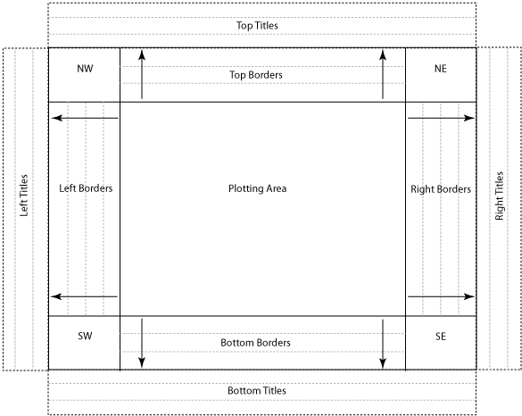
Rayon’s “Canvas” nomenclature

Slide 104
Resources
http://tools.netsa.cert.org/
http://tools.netsa.cert.org/rayon/doc/index.html
http://tools.netsa.cert.org/silk/index.html
http://www.graphviz.org/
http://www.r-project.org/

Slide 105
Bibliography
Tufte
Segaran and Hammerbacher
Ben Shneiderman

Slide 106

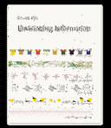
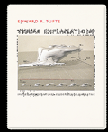

Tufte
Edward Tufte is the recognized authority on data visualization
http://www.edwardtufte.com/tufte/
Seminar
Books

Slide 107
Paul Krystosek pnk@cert.org Analysis Team Lead Network Situational Awareness Group CERT Software Engineering Institute Carnegie Mellon University Pittsburgh, PA
Contact Info

